Slide 1

ITS30705 CHAPTER 1: INTRODUCTION TO PROBLEM SOLVING USING ALGORITHM

Slide 2
CONTENT
Introduction to Programming
Problem Solving
Pseudocode

Slide 3
INTRODUCTION
A computer can be defined as an electronic machine, operating under the control of instructions stored in its own memory, that can accept data, manipulate data and produce results that can be stored for future use.
These set of instructions is called program.
A program contains many operations, and a computer must be programmed to perform different tasks
A programming language can be divided into machine language, assembly language, and high-level language.

Slide 4
Machine language
The natural language of a particular computer.
Defined by the hardware design of the computer
Consist of strings of number (0 and 1) that construct computers to perform their operations.
Machine dependent. Machine language can be used only for one type of computer.
Cumbersome for humans

Slide 5
Assembly language
English-like abbreviations languages
Translator programs called assemblers were developed to convert assembly programs to machine language at computer speeds.
Clearer and easier to understand as compared to machine language.
However, it requires many statements in order to perform a simple tasks.
Example: MOV AL, 88h.

Slide 6
High-level language
Developed the speed of programming process.
Developed in which single statements could be written to accomplish substantial tasks.
Compiler is used to convert high-level language programs into machine language.
High-level languages allow programmers to write instructions that took almost like everyday English and contain commonly used mathematical notations.
Python is one of the high-level language.

Slide 7
Problem solving
The purpose of writing a program is to solve a problem or performing certain tasks.
Before writing a program to solve a problem. It is essential to have a clear understanding of the problem and a carefully planned approach to solve a problem.
Any computing problem can be solved by executing a series of actions in a specific order.
A procedure for solving problem in terms of the actions to be executed and the order in which actions are to be executed is called an algorithm.

Slide 8
PROBLEM SOLVING
Below are the general steps of problem solving in programming.
Understand the problem. Solve the problem manually with a few examples.
Devise an algorithm to solve the problem.
Write the program using the programming syntax and run the program.
Correct the syntax error after the compilation. Save the program and run again.
Finally test the results against expected output. If the results are not correct, modify the algorithm, rewrite and re-run the program.

Slide 9
Problem solving
Strategies
What do I know about the problem?
What is the information that I have in order to find the solution?
What does the solution look like?
What sort of special cases exist?
How will I recognize that I have found the solution?

Slide 10
Problem solving
Syntax – A set of rules, principles, and processes that govern the structure of element in a programming language.
Semantic – Describe the meaning of the things written while following the syntax rules of the language. Semantic describes the things happen when a program is executed.
Debugging – A process of eliminating mistakes in the program. A mistake in a program is called a bug.

Slide 11
PROBLEM SOLVING
There are four commonly types of bugs or errors.
TypeError
Raised when a function or operation is applied to an object of an incorrect type.
IndentationError
Raised when there is an incorrect indentation.
AttributeError
Raised on the attribute assignment or reference fails
IndexError
Raised when the index of a sequence is out of range.

Slide 12
Writing algorithms
There are several methods of writing algorithms before attempting to program a solution. Here are three frequently used methods:
Structured English
Flowchart
Pseudocode

Slide 13
STRUCTURED ENGLISH
Structured English is a method of showing the logical steps in an algorithm, using an agreed subset of straightforward English words for commands and mathematical operations to represent the solution. These steps can be numbered.
Ask for the number of values
Loop that number of times
Enter a value in loop
Add the value to the Total in loop
Calculate and output average

Slide 14
PSEUDOCODE
Pseudocode is an informal high-level description of the operating principle of a computer program or algorithm. It is simply a numbered list of instructions to perform some task.
Best practices
Write only one statement per line and each statement should express just one action.
Get the name of the participant
Compute the total salary
Display the number of students

Slide 15
PSEUDOCODE
All identifier name used should be meaningful.
It is a good practice to keep track of any identifiers used in an identifier table.
Identifier Name | Description
StudentName | Store a student name
Counter | Store a loop counter
StudentMark | Store a student mark

Slide 16
PSEUDOCODE
To input a value:
To output a message or value or a combination:
To assign a value to a variable:
INPUT StudentName
OUTPUT “You have made an error”
OUTPUT StudentName
OUTPUT “Student name is”,StudentName
Counter <- 1
Counter <- Counter + 1
MyChar <- “A”
Percentage <- (StudentMark / 80) * 100

Slide 17
PSEUDOCODE
Operators used in pseudocode assignment statements:
+ Addition
- Subtraction
* Multiplication
/ Division
& String concatenation
<- Assignment

Slide 18
PSEUDOCODE
To perform selection using IF statements for
a single choice
A single choice with alternative
A multiple choice
IF MyValue > YourValue
OUTPUT “I win”
ELSE IF YourValue > MyValue
OUTPUT “You win”
ELSE
OUTPUT “Draw”
ENDIF
IF MyValue > YourValue
OUTPUT “I win”
ENDIF
IF MyValue > YourValue
OUTPUT “I win”
ELSE
OUTPUT “You win”
ENDIF

Slide 19
PSEUDOCODE
Operators used in pseudocode selection statements:
== Equal to
!= Not equal to
> Greater than
< Less than
>= Greater than or equal to
<= Less than or equal to

Slide 20
PSEUDOCODE
To perform iteration using FOR LOOPS
To perform iteration using WHILE LOOP
Total <- 0
FOR Counter <- 1 TO 10
OUTPUT “Enter a number”
INPUT Number
Total <- Total + Number
NEXT Counter
OUTPUT “The total is”, Total
Number <- 0
WHILE Number >= 0
OUTPUT “Please enter a negative number”
INPUT Number
ENDWHILE

Slide 21
Pseudocode exercise
Question 1
Write a program that asks the user for a temperature in Fahrenheit and prints out the same temperature in Celsius.

Slide 22
PSEUDOCODE ANSWER
Identify the input, process, and output.
Input – temperature in Fahrenheit
Process – convert temperature in Fahrenheit to temperature to Celsius
Output – temperature in Celsius
Write in Pseudocode
INPUT Fahrenheit
Celsius = (Fahrenheit – 32) * 5/9
OUTPUT Celsius

Slide 23
Pseudocode exercise
Question 2
Write a program that calculate the total payment to be made by a customer that includes service charge and good and service tax (GST).
Total Price = RM 109.70
Service Charge = 10%
GST = 6%

Slide 24
PSEUDOCODE ANSWER
Identify the input, process, and output.
Input – total price
Process – total payment that includes service charge and GST
Output – total payment
Write in Pseudocode
INPUT TotalPrice
TotalPayment = TotalPrice + (TotalPrice * 0.1) + (TotalPrice * 0.06)
OUTPUT TotalPayment

Slide 25
Pseudocode exercise
Question 3
Write a program that check whether the user is eligible for voting or not. (Note: The eligible age for voting is 18)

Slide 26
PSEUDOCODE ANSWER
Identify the input, process, and output.
Input – age
Process – check the age of the user
Output – display whether the user is eligible for voting or not
Write in Pseudocode
INPUT Age
IF Age > 18 OUTPUT “Eligible for voting”
ELSE OUTPUT “Not eligible for voting”
ENDIF

Slide 27
FLOWCHART
A flowchart is a type of diagram that represents an algorithm or process.
A flowchart shows the steps as boxes of various kinds, and their order by connecting them with arrows.
Used in analyzing, designing, documenting, or managing a process or program.
Example application: Lucidchart, Draw.io

Slide 28
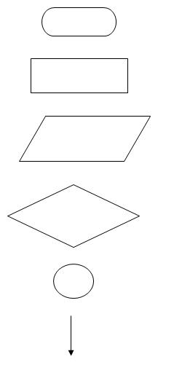
FLOWCHART – NOTATION
Start / End
Assignment <- using a calculation or a pre-defined process
INPUT or OUTPUT
IF, FOR, and WHILE
Connector
Activity Flow

Slide 29
Flowchart – Example
A
Flowchart: How to cook rice
Start
Put the lid on
INPUT a cup of rice
Switch on the rice cooker
Pour into the rice cooker pot
Wait for the rice to cook
No
Put twice the amount of water into the pot
Clicking sound
Yes
Return pot to rice cooker
Turn the power off
A
End

Slide 30
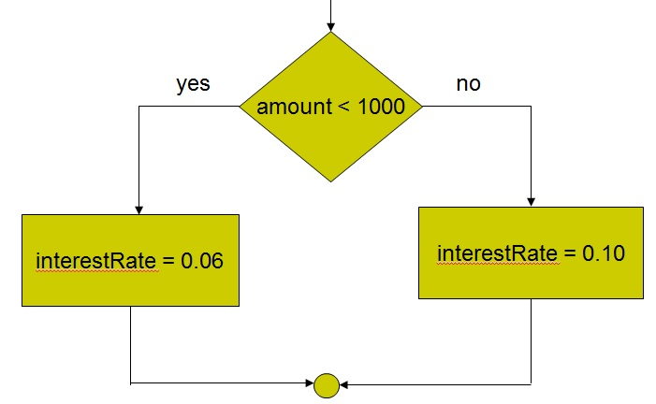
Flowchart
Selection Structure

Slide 31
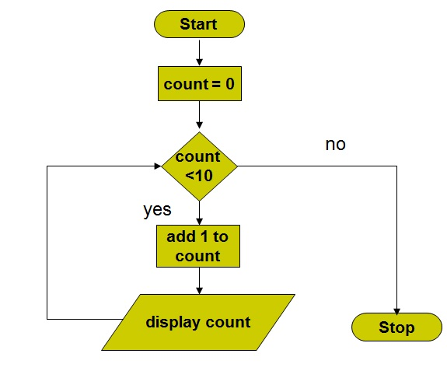
FLOWCHART
Repetition Structure

Slide 32
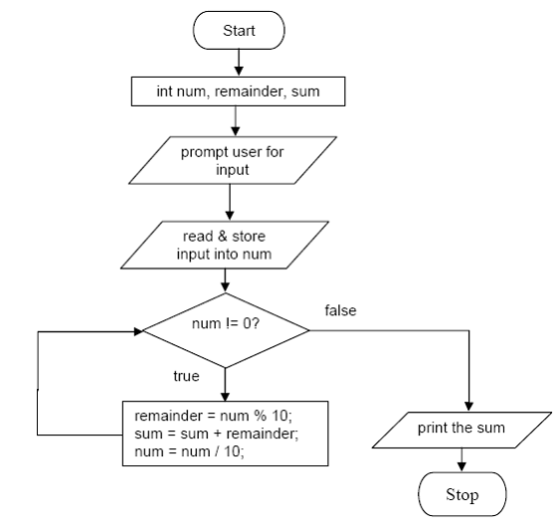
FLOWCHART – EXAMPLE

Slide 33
FLOWCHART – Exercise
Question 1
Write a program that asks the user for a temperature in Fahrenheit and prints out the same temperature in Celsius.
Pseudocode
INPUT Fahrenheit
Celsius = (Fahrenheit – 32) * 5/9
OUTPUT Celsius

Slide 34
FLOWCHART – Exercise
Start
INPUT Fahrenheit
Celsius = (Fahrenheit – 32) * 5/9
OUTPUT Celsius
End

Slide 35
FLOWCHART – Exercise
Question 2
Write a program that calculate the total payment to be made by a customer that includes service charge and good and service tax (GST).
Total Price = RM 109.70
Service Charge = 10%
GST = 6%
Pseudocode
INPUT TotalPrice
TotalPayment = TotalPrice + (TotalPrice * 0.1) + (TotalPrice * 0.06)
OUTPUT TotalPayment

Slide 36
FLOWCHART – Exercise
Start
INPUT TotalPrice
TotalPayment = TotalPrice + (TotalPrice * 0.1) + (TotalPrice * 0.06)
OUTPUT TotalPayment
End

Slide 37
FLOWCHART – Exercise
Question 3
Write a program that check whether the user is eligible for voting or not. (Note: The eligible age for voting is 18).
Pseudocode
INPUT Age
IF Age > 18 OUTPUT “Eligible for voting”
ELSE OUTPUT “Not eligible for voting”
ENDIF

Slide 38
FLOWCHART – Exercise
Start
INPUT Age
Age > 18
OUTPUT “Not eligible for voting”
OUTPUT “Eligible for voting”
End

